Slide 1



Capstone Project-lll
Mobile price range prediction by Ashveen Kumar Verma (Self)

Slide 2

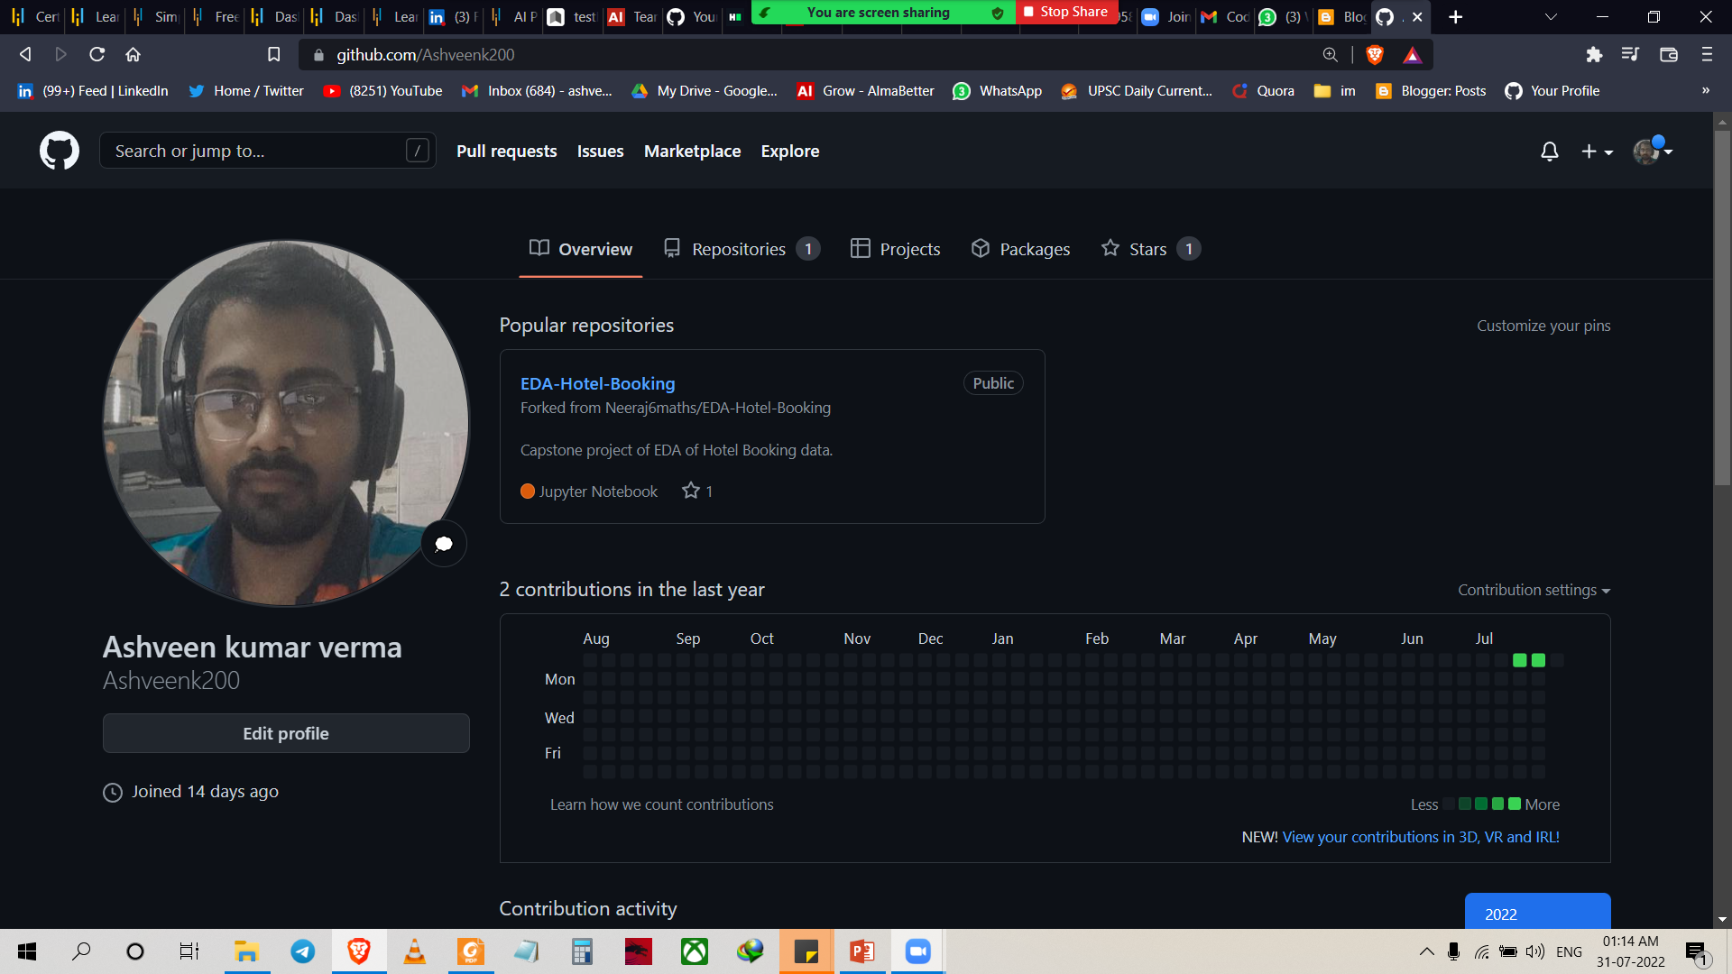
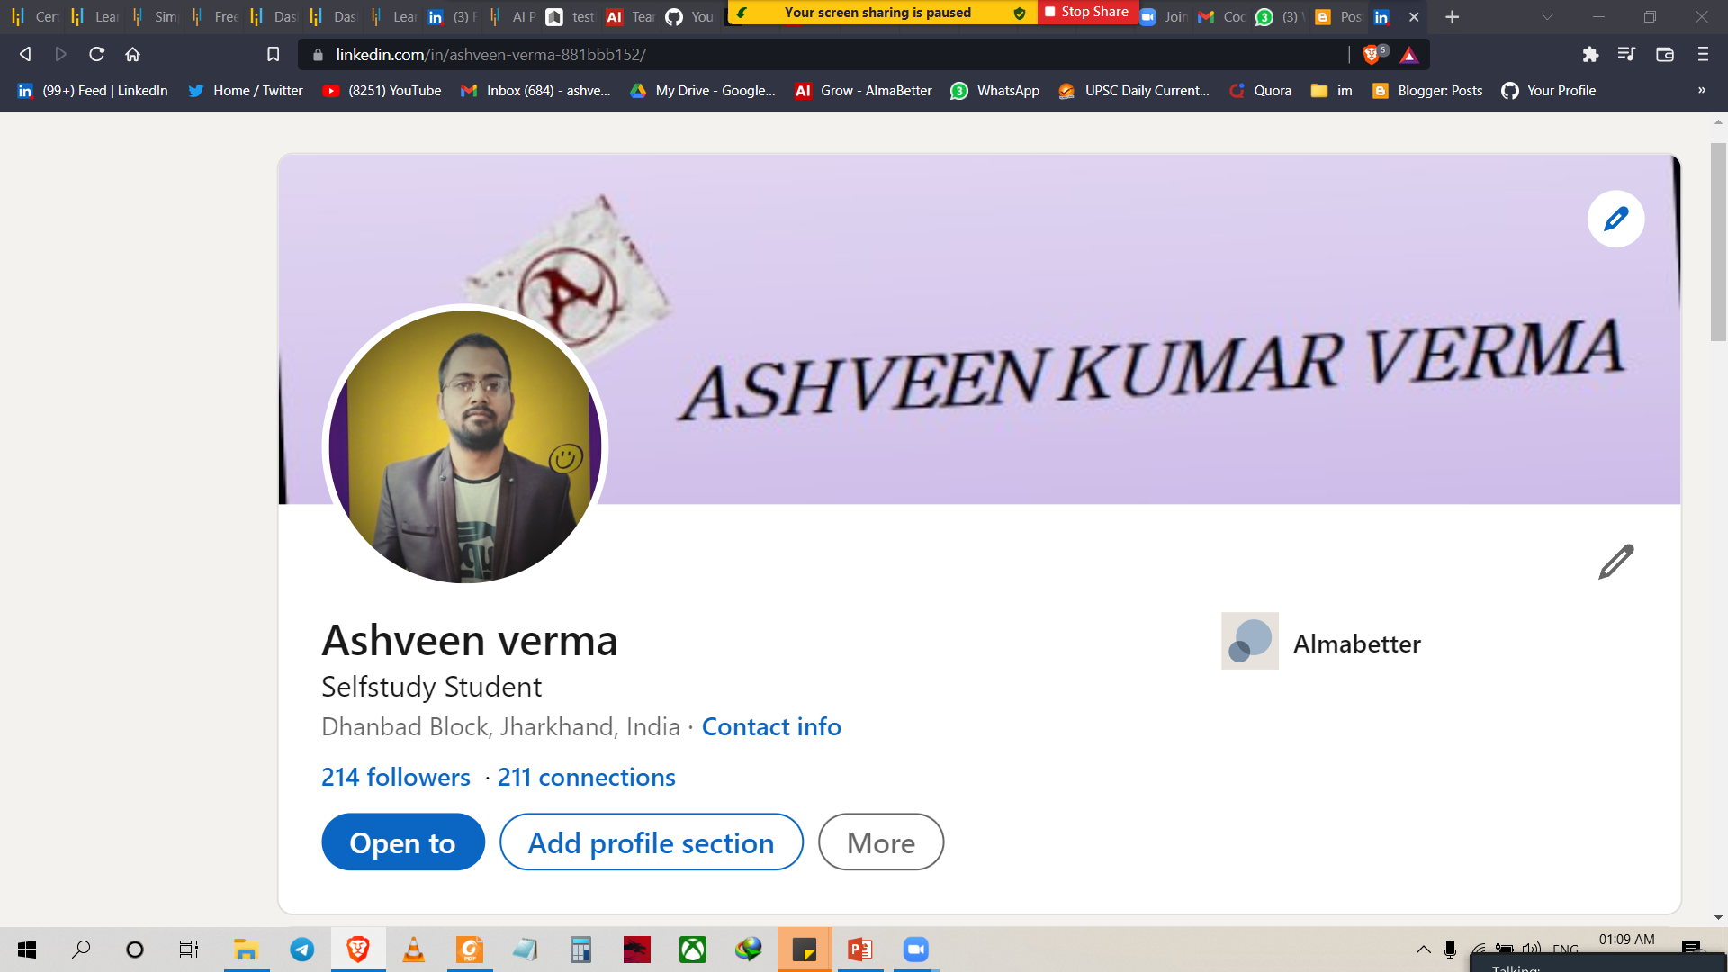

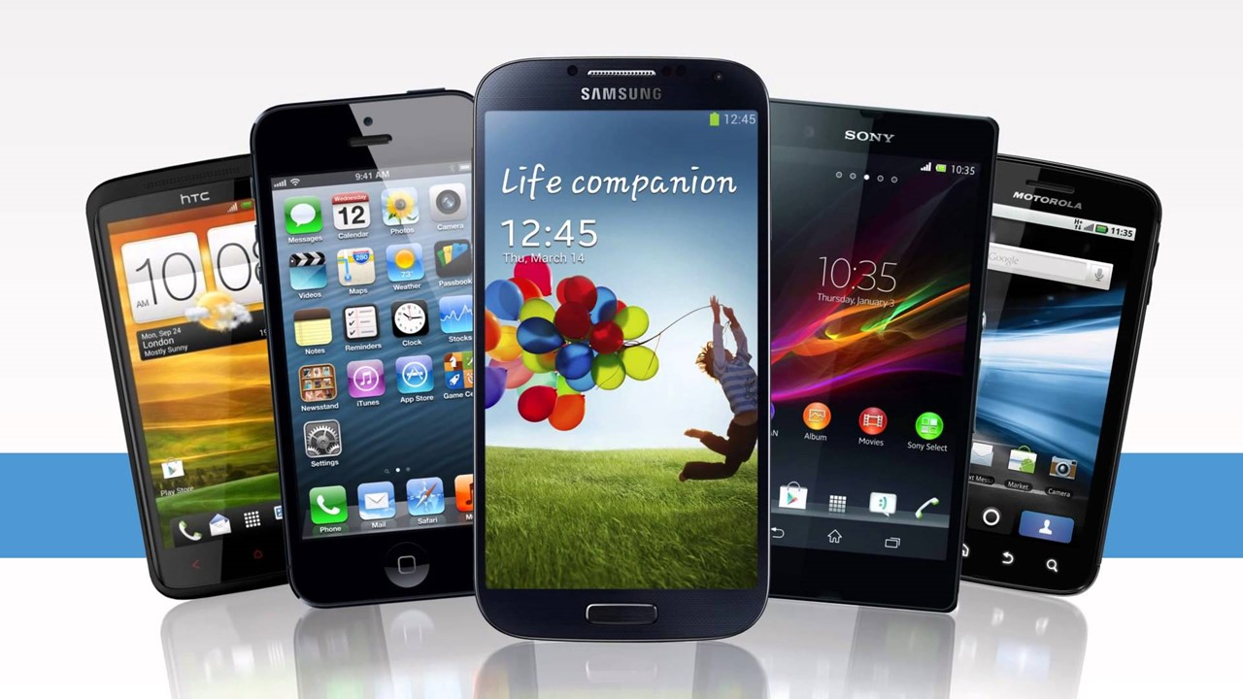
ASHVEEN KUMAR VERMA
Live in Dhanbad Jharkhand
Bsc graduate from pk roy memorial collage Dhanbad in 2020.
Enrolled in DS program.
This is my 3rd capstone project
Linkedin- Ashveen verma
Github- Ashveen kumar verma
Twitter- Ashveen kumar verma

Slide 3
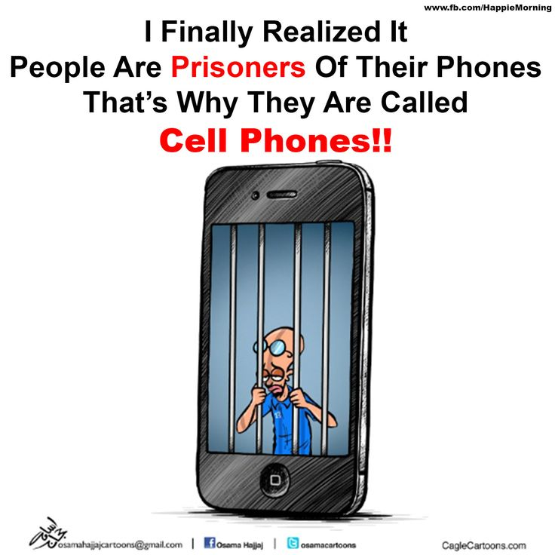
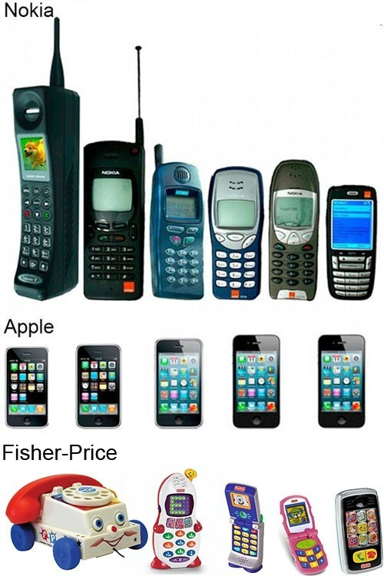
Problem Statement
We have to predict price of mobile phone using some test and train data by the help of linear regression , logestic regression , decision tree etc, and also measuring the accuracy level.

Slide 4
Work Flow:-
In the competitive mobile phone market companies want to understand sales data of mobile phones and factors which drive the prices. The objective is to find out some relation between features of a mobile phone(eg:- RAM, Internal Memory, etc) and its selling price. In this problem, we do not have to predict the actual price but a price range indicating how high the price is.
After collecting data it’s important to understand your data . So we had mobile price prediction data which had 2000 rows and 21 columns. So lets understand this 21 columns.

Slide 5
Data Description:-
Battery_power - Total energy a battery can store in one time measured in mAh
Blue - Has bluetooth or not
Clock_speed - speed at which microprocessor executes instructions
Dual_sim - Has dual sim support or not
Fc - Front Camera mega pixels
Four_g - Has 4G or not
Int_memory - Internal Memory in Gigabytes
M_dep - Mobile Depth in cm
Mobile_wt - Weight of mobile phone
N_cores - Number of cores of processor
Pc - Primary Camera mega pixels
Px_height - Pixel Resolution Height
Px_width - Pixel Resolution Width
Ram - Random Access Memory in Mega Bytes
Sc_h - Screen Height of mobile in cm
Sc_w - Screen Width of mobile in cm
Talk_time - longest time that a single battery charge will last when you are
Three_g - Has 3G or not
Touch_screen - Has touch screen or not
Wifi - Has wifi or not
Price_range - This is the target variable with value of 0(low cost), 1(medium cost), 2(high cost) and 3(very high cost).

Slide 6
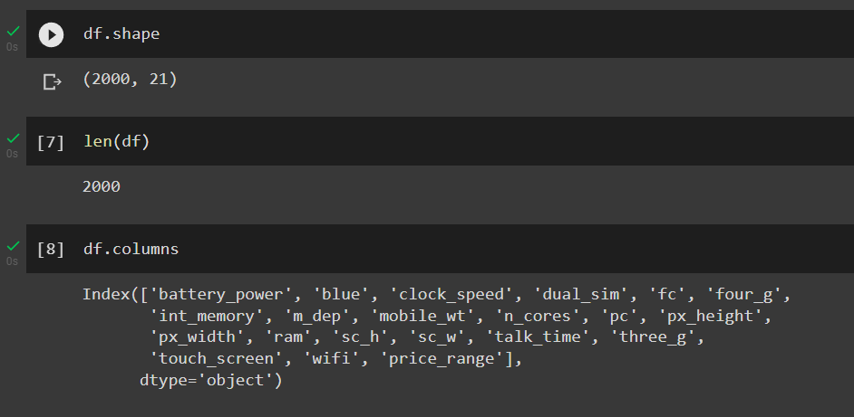
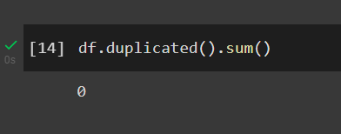
Data cleaning and Manupulation :-

Slide 7
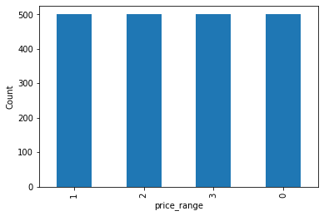
correlation matrix
1) value of 0(low cost), 1(medium cost), 2(high cost) and 3(very high cost)2)
Conclusion:-
* Demand of all range of phone is equal. So all the range of phone is equal

Slide 8
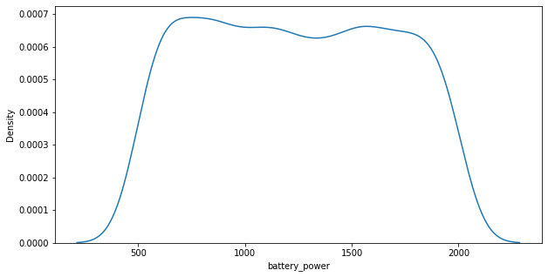
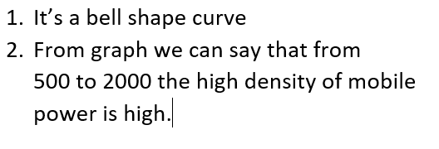
Exploratory Data Analysis(EDA)

Slide 9
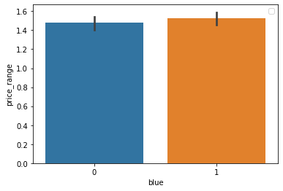
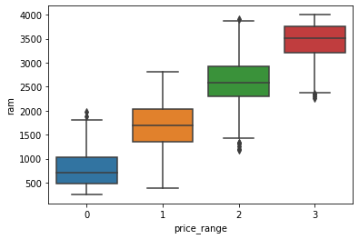
Exploratory Data Analysis(EDA)
Conclusion:-
From graph we can say that the the Bluetooth vs price range of low cost mobile and high cost mobile is almost same. same in graph 2 ,but accept some outliers.

Slide 10
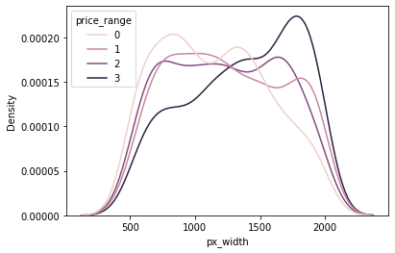
Exploratory Data Analysis(EDA)

Slide 11
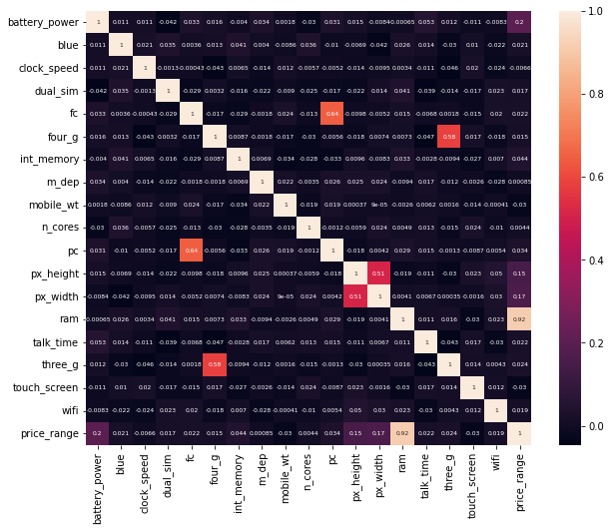

Slide 12
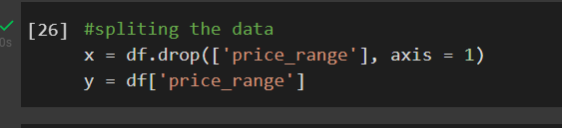
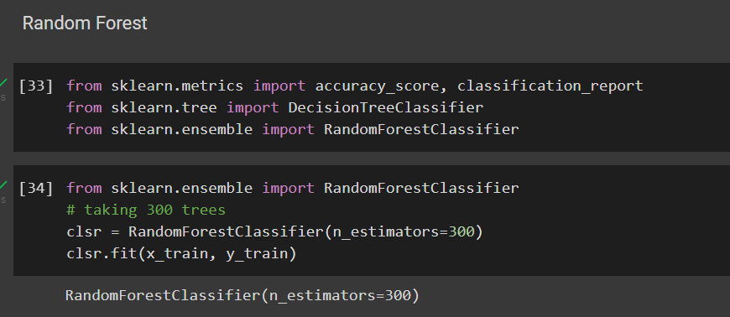
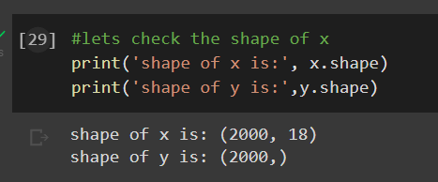
Exploratory Data Analysis(EDA)

Slide 13
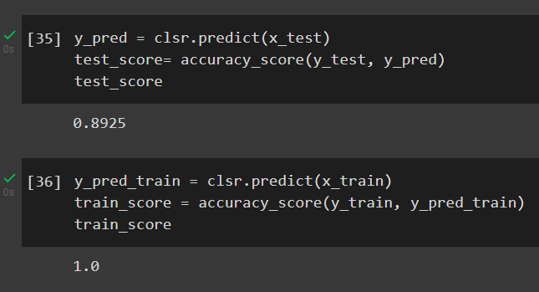
Exploratory Data Analysis(EDA)

Slide 14
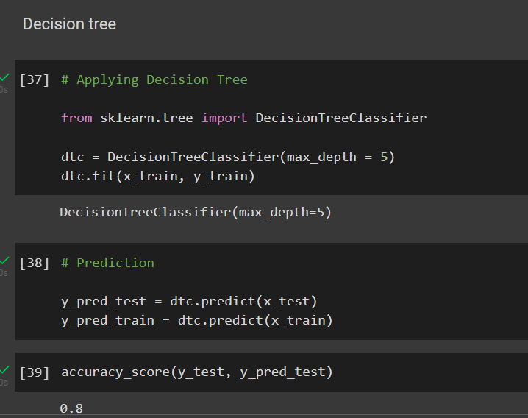
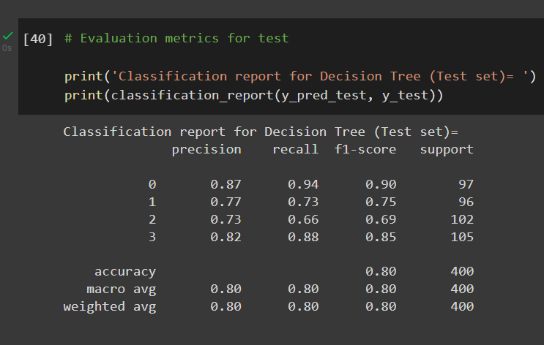

Slide 15
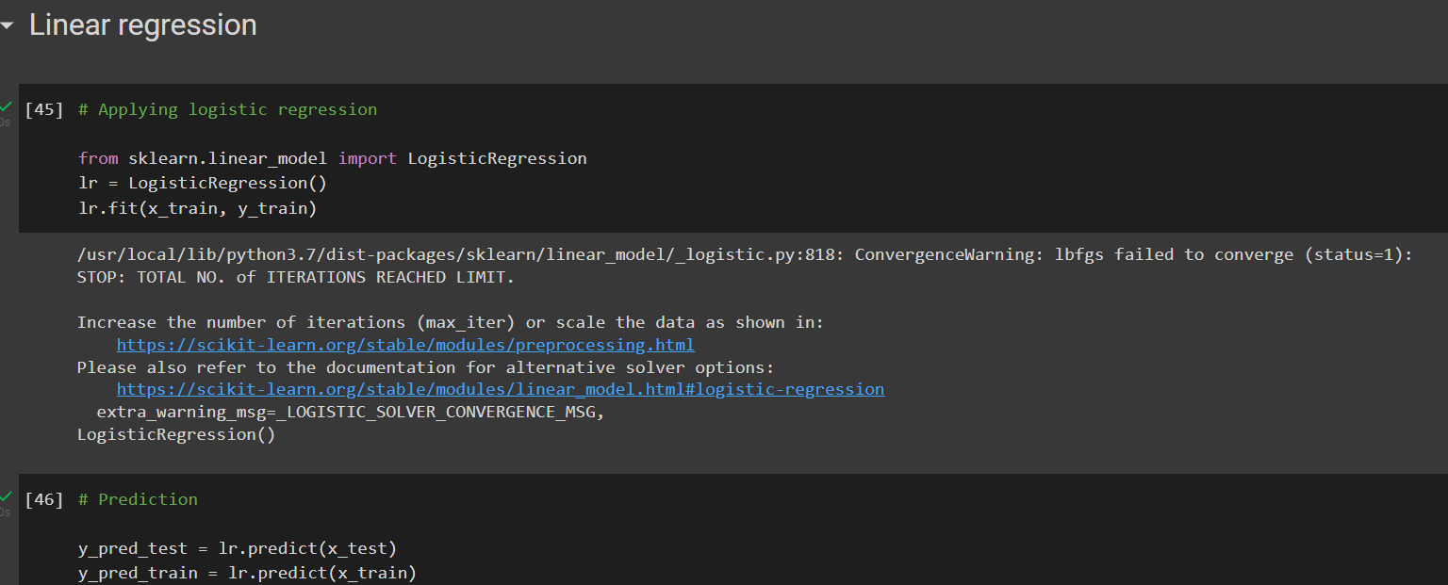

Slide 16
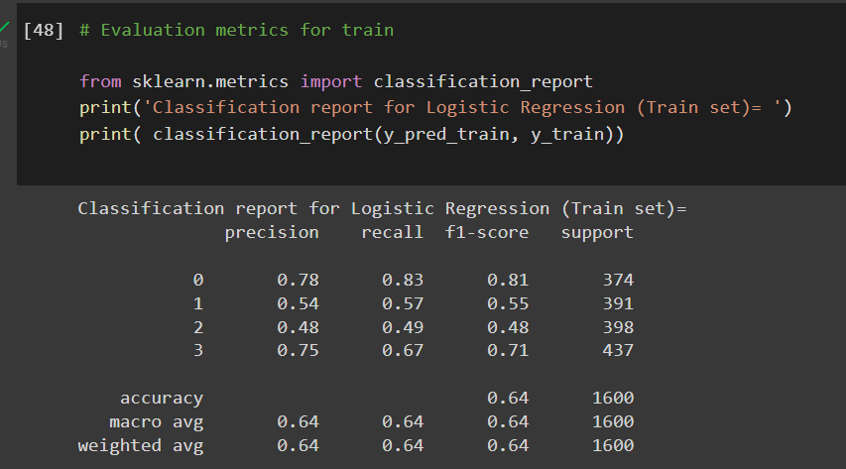

Slide 17
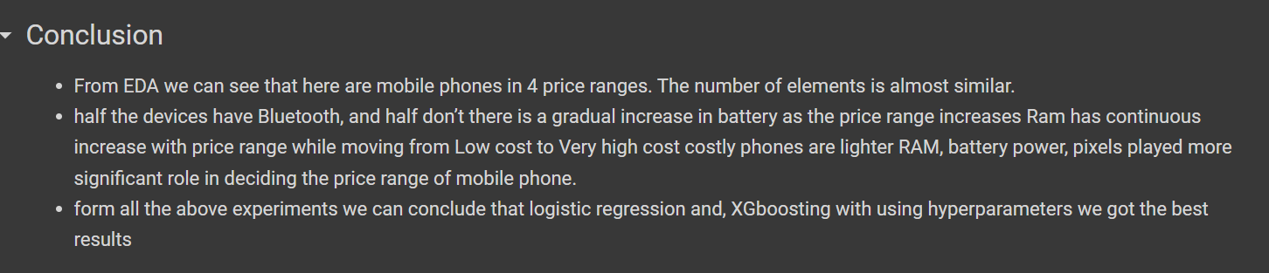
Exploratory Data Analysis(EDA)

Slide 18


